Slide 1

SEMINAR ON
“Smart Device to Enhance Safety of the Vehicle”
SUBMITTED TO THE SAVITRIBAI PHULE PUNE UNIVERSITY, PUNE
IN THE PARTIAL FULFILLMENT FOR THE AWARD OF THE DEGREE
OF
BACHELOR OF ENGINEERING
IN
COMPUTER ENGINEERING
BY
THOPATE RUTURAJ SATISH (CO3073)
Under the Guidance of: -
Prof. Rutika Shah
DEPARTMENT OF COMPUTER ENGINEERING
KJ’S EDUCATIONAL INSTITUTE
TRINITY COLLEGE OF ENGINEERING
AND RESEARCH

Slide 2
Introduction
This Project presents associate degree automotive localization system exploitation GPS services. The system permits localization of the car and sending the Position to the owner on his /her mobile as a brief message (SMS) at his/her request. just in case of car stealing things, the owner will recognize the vehicle’s current location and supported that he/she will stop the vehicle by causation a predefined SMS message to the current system. once receiving SMS message from owner this technique mechanically stops the ignition thence the vehicle won't perform from now on. we will perceive the most method of the system.

Slide 3
Literature Survey
Rajatabh Agarwal, Boominathan P., “Vehicle Security System Using IOT Application”, International Research Journal of Engineering and Technology (IRJET), 2018.
Girish B. G., Akhilesh D Gowda, Hajira Amreen, Amit, K. M. Apoorva Singh, “IOT Based Security System For Smart Vehicle”, International Research Journal of Engineering and Technology (IRJET), 2018.
Mohammed F. Alrifaie, Norharyati Harum, Mohd Fairuz Iskandar Othman, Irda Roslan, Methaq Abdullah Shyaa, “Vehicle Detection and Tracking System IoT based: A Review”, International Research Journal of Engineering and Technology (IRJET), 2018.
N. Upendra Yadav, Prof. Kamalakannan, “Smart Vehicle Monitoring System using IOT”, IJDCST, MarchApril-2017.
H. V. Dadwani, R. B. Bukta, “Vehicle Tracking and Anti-Theft System Using Internet of Things”, International Journal 77of Advances in Electronics and Computer Science, 2017

Slide 4
Sr.No | Author | Name of Paper | Proposed Work | Techniques | Limitation
1 | Rajatabh Agarwal, Boominathan | International Research Journal of Engineering and Technology (IRJET), 2018. | “Vehicle Security System Using IOT Application” | IoT Devices Mobile Application | Only focus on the application base technology
2 | Girish B. G., Akhilesh D Gowda | International Research Journal of Engineering and Technology (IRJET) | IOT Based Security System For Smart Vehicle | GPS technology | Using GPS the network and the response of device are slow
3 | Mohammed F. Alrifaie | International Research Journal of Engineering and Technology (IRJET) | Vehicle Detection and Tracking System IoT based: A Review | Cloud platform Server application | Some times works in the limited coverage area.n
4 | N. Upendra Yadav | International Research Journal of Engineering and Technology (IRJET) | Smart Vehicle Monitoring System using IOT | IOT Device like Arduino Uno Various applications | The process is very old no better to use In todays Conditions

Slide 5
Details of Design/Technology/Architecture
GPS technology
The Global Positioning System (GPS) could be a system supported world navigation satellite system (GNSS) that offer reliable location and time info in the least time in any whether or not condition on earth. it's composed of a network of twenty four satellites of the u. s. that are antecedently employed in military services, and later allowed for business use. The satellite emits radio radiation of short pulses to GPS receiver sporadically. A GPS receiver receives the signal from a minimum of four satellites to reason its three-dimension position that's latitude, meridian and altitude. Therefore, GPS could be a key technology for locating a tool location.

Slide 6
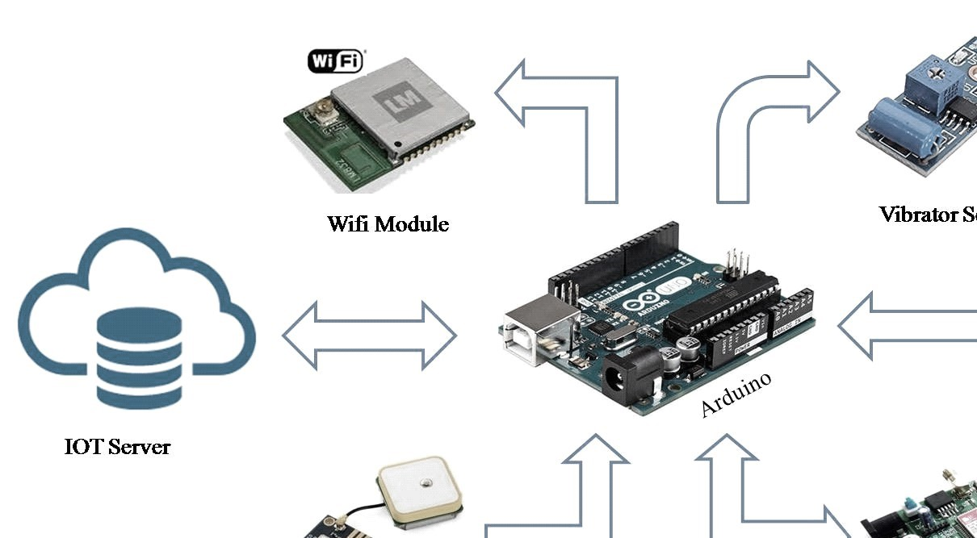
HARDWARE REQUIREMENT
Processor: Intel Core I3 or Higher
RAM: 2GB or Higher
HDD: 50GB (min)
• Microcontroller: Arduino
Device: Android Mobile
WIFI Module
GPS Module
GSM Module
Vibrator Sensor
SOFTWARE REQUIREMENT
OS: Microsoft Windows 7 or Above
Programming Language: Android, JAVA, Embedded C
Database: MySQL
IDE: Net Beans, Android Studio, Arduino IDE

Slide 7
Analytical / Experimental Work/Working
1. Vehicle module
Automatic On/Off
Automatic Lock/Unlock
Vehicle theft detection
Update location
Send Notification

Slide 8
2. IOT module
In this module, output is given to Arduino to send the message to the vehicle owner via IOT module.
Vehicle location
Vehicle ON/OFF by thief
3. Vehicle owner module
Vehicle owner is present where all the activities are managed.
Receive notification
Send notification
Check current location

Slide 9
Application
Vehicle Tracking and Recovery: GPS trackers can be used to monitor the real-time location of a vehicle. In case of theft, they help law enforcement track and recover the stolen vehicle.
Teen Driver Monitoring: Parents can use GPS trackers to monitor the driving habits and whereabouts of their teenage drivers. Some devices offer speed alerts, geofencing, and other safety features.
Route Planning and Navigation: GPS trackers and navigation systems provide turn-by-turn directions, real-time traffic updates, and points of interest, making it easier for drivers to navigate unfamiliar areas.
Vehicle Maintenance: Some GPS trackers monitor vehicle health by tracking engine diagnostics and alerting owners to maintenance needs, helping to prevent breakdowns and costly repairs.
Emergency Assistance: Many GPS trackers have SOS buttons that allow drivers to send distress signals or call for emergency assistance.

Slide 10
Future scope
The main scope of this project is to prevent the engine of associate degree automobile mechanically. this may be done whenever an individual making an attempt to steal the vehicle, at that point sends associate degree interrupt to a programmable microcontroller that stores owner's variety upon a text message for the primary time.

Slide 11
Conclusions
In our project the protection system relies on embedded management that provides security against thieving. The GSM electronic equipment provides info to the user on his request. The owner will access the position of the vehicle at any instant. She/he sends a message so as to lock the vehicle. The GPS receiver on the kit can find the latitude and meridian of the vehicle victimisation the satellite service. This project deals with the look & development of a thieving system for vehicle additionally as defend the lifetime of rider.

Slide 12
Thank you…!
Ruturaj Satish Thopate
TE-Computer
CO3073

